Slide 1
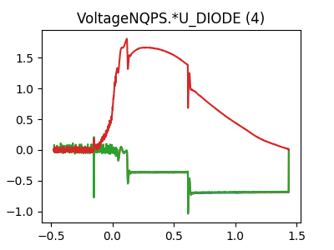
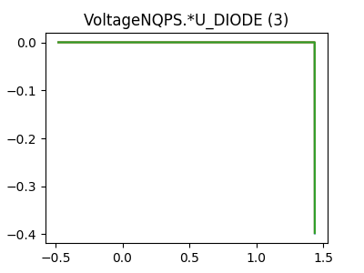
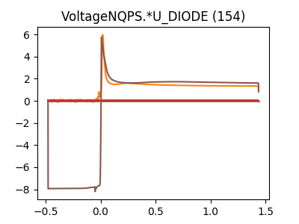
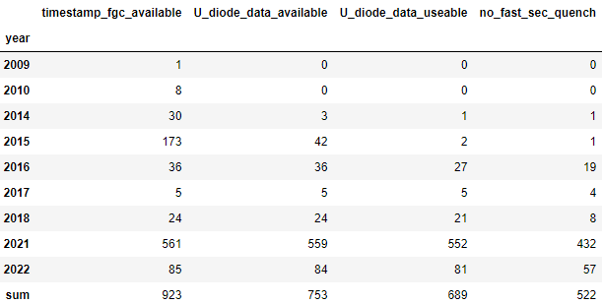
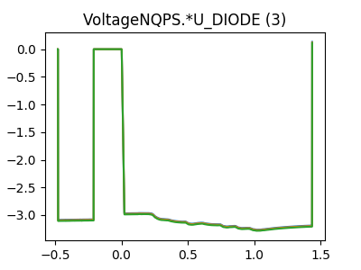
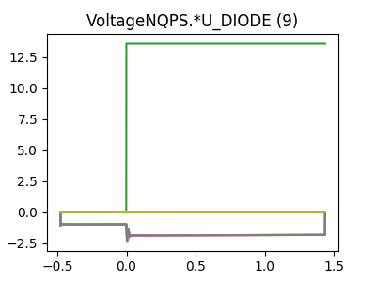
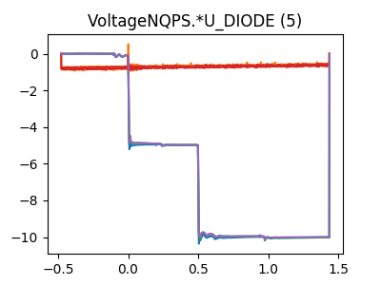
Data Overview
Filtered events

Slide 2
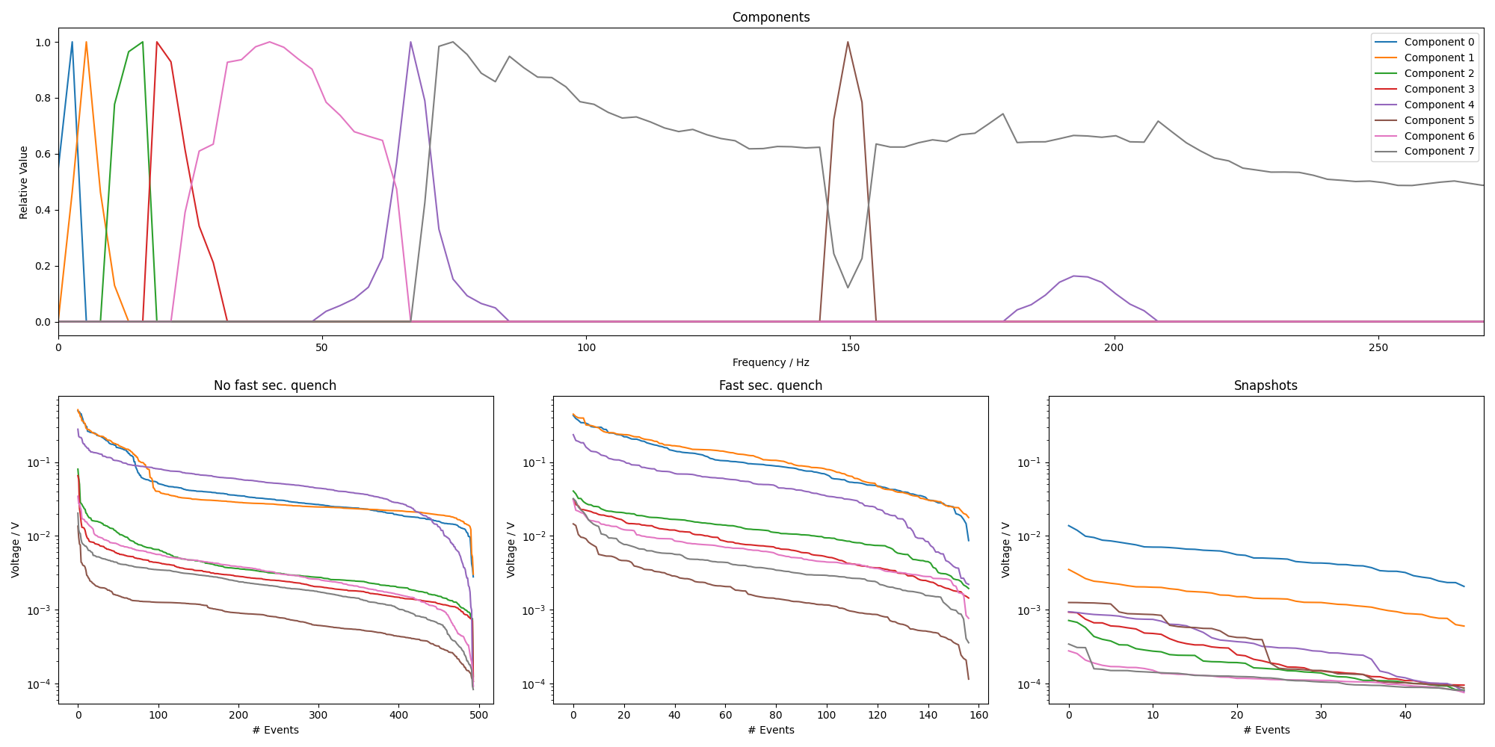
1EE

Slide 3
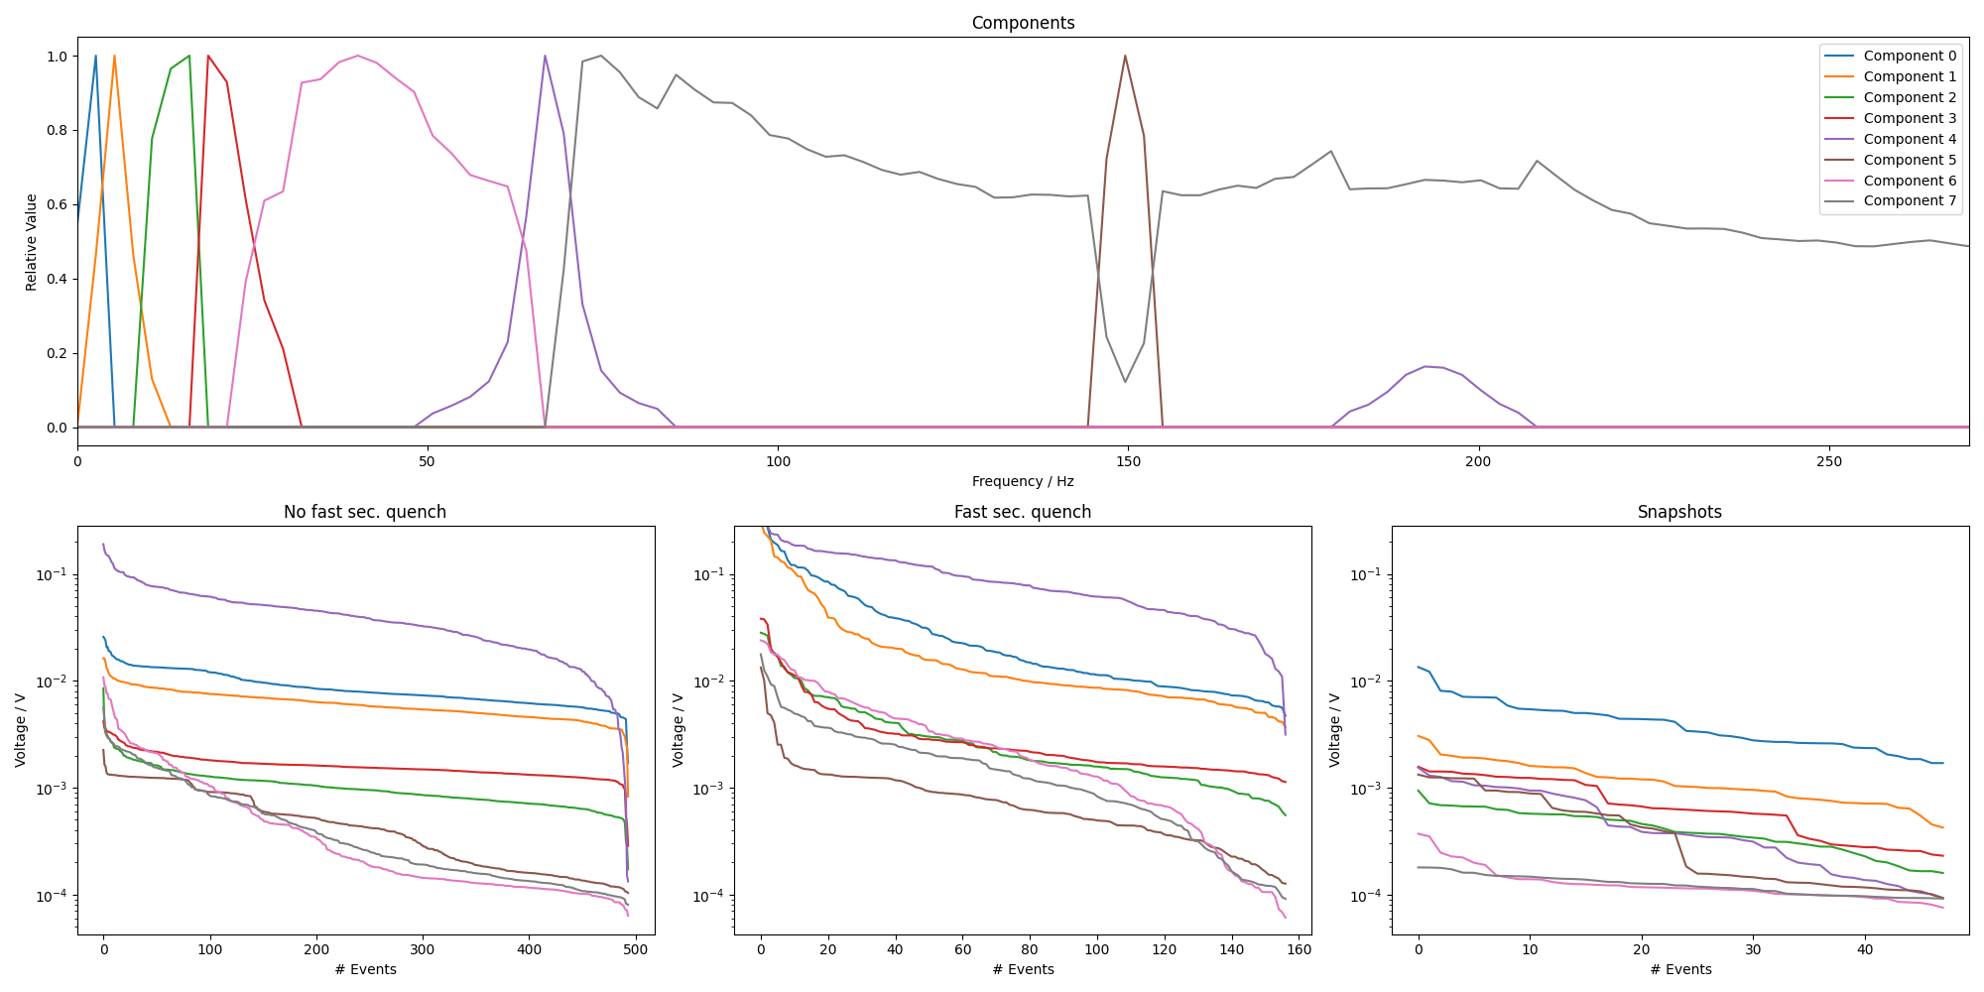
2EE

Slide 4
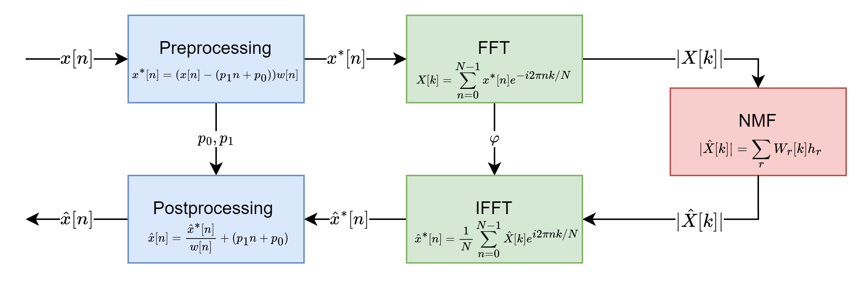
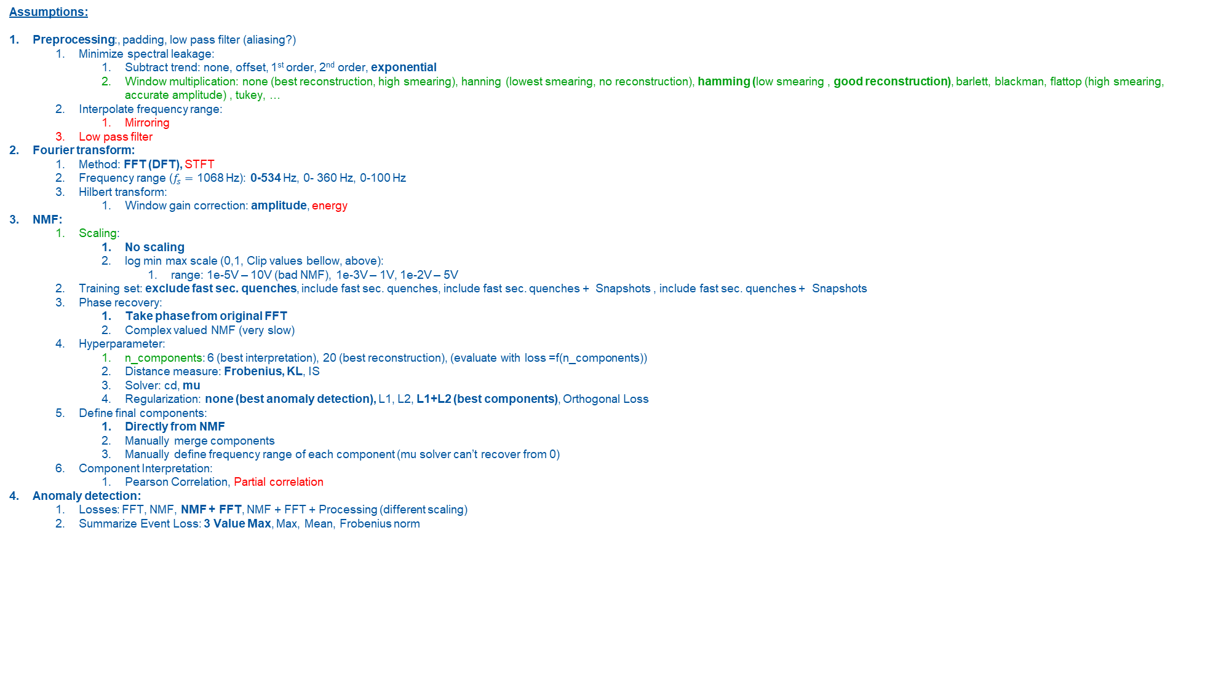
Assumptions:
Preprocessing:, padding, low pass filter (aliasing?)
Minimize spectral leakage:
Subtract trend: none, offset, 1st order, 2nd order, exponential
Window multiplication: none (best reconstruction, high smearing), hanning (lowest smearing, no reconstruction), hamming (low smearing , good reconstruction), barlett, blackman, flattop (high smearing, accurate amplitude) , tukey, …
Interpolate frequency range:
Mirroring
Low pass filter
Fourier transform:
Method: FFT (DFT), STFT
Frequency range ($f_{s}=$ 1068 Hz): 0-534 Hz, 0- 360 Hz, 0-100 Hz
Hilbert transform:
Window gain correction: amplitude, energy
NMF:
Scaling:
No scaling
log min max scale (0,1, Clip values bellow, above):
range: 1e-5V – 10V (bad NMF), 1e-3V – 1V, 1e-2V – 5V
Training set: exclude fast sec. quenches, include fast sec. quenches, include fast sec. quenches + Snapshots , include fast sec. quenches + Snapshots
Phase recovery:
Take phase from original FFT
Complex valued NMF (very slow)
Hyperparameter:
n_components: 6 (best interpretation), 20 (best reconstruction), (evaluate with loss =f(n_components))
Distance measure: Frobenius, KL, IS
Solver: cd, mu
Regularization: none (best anomaly detection), L1, L2, L1+L2 (best components), Orthogonal Loss
Define final components:
Directly from NMF
Manually merge components
Manually define frequency range of each component (mu solver can’t recover from 0)
Component Interpretation:
Pearson Correlation, Partial correlation
Anomaly detection:
Losses: FFT, NMF, NMF + FFT, NMF + FFT + Processing (different scaling)
Summarize Event Loss: 3 Value Max, Max, Mean, Frobenius norm

Slide 5
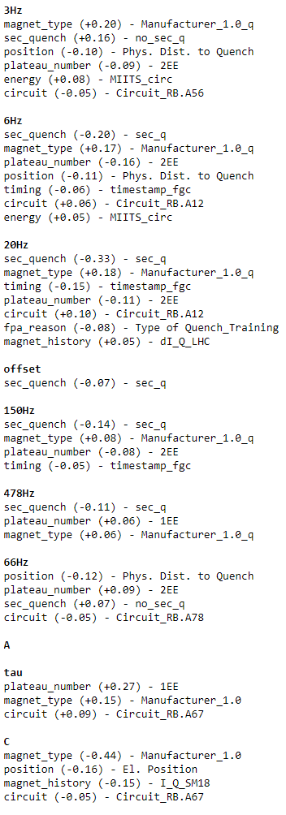
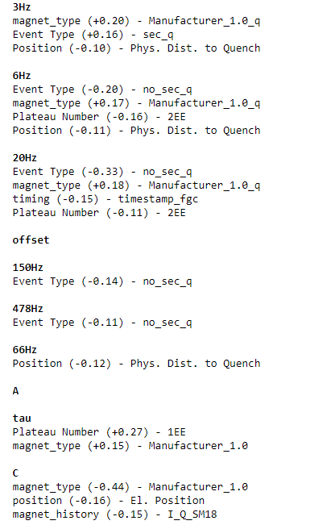
Pearson Correlations

Slide 6
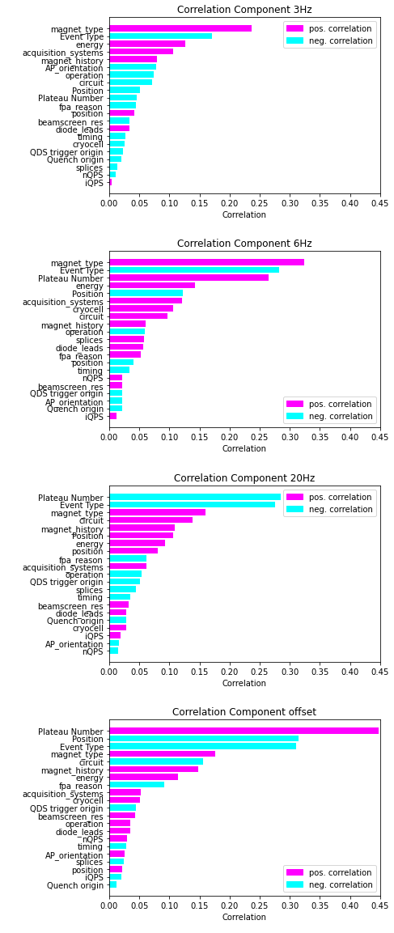
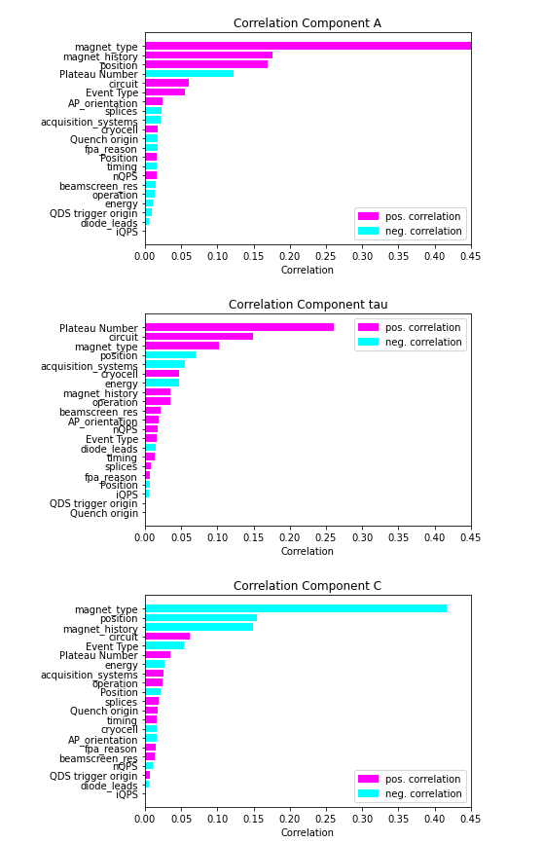
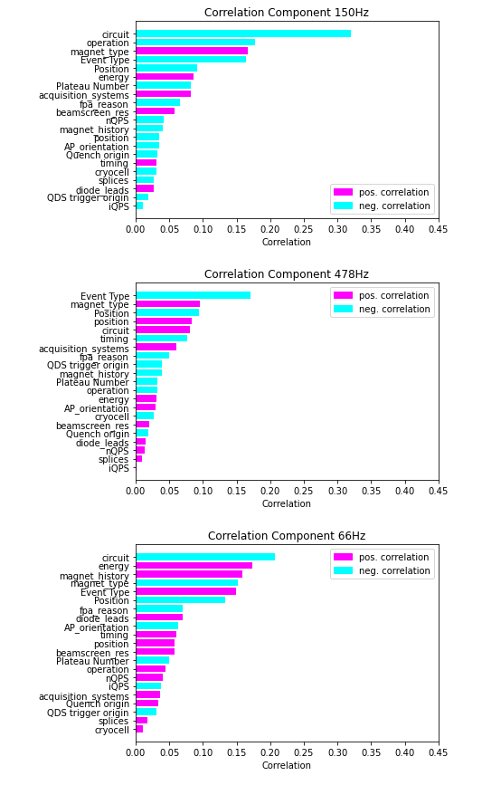
Spearman Correlation

Slide 7
Final Components

Slide 8
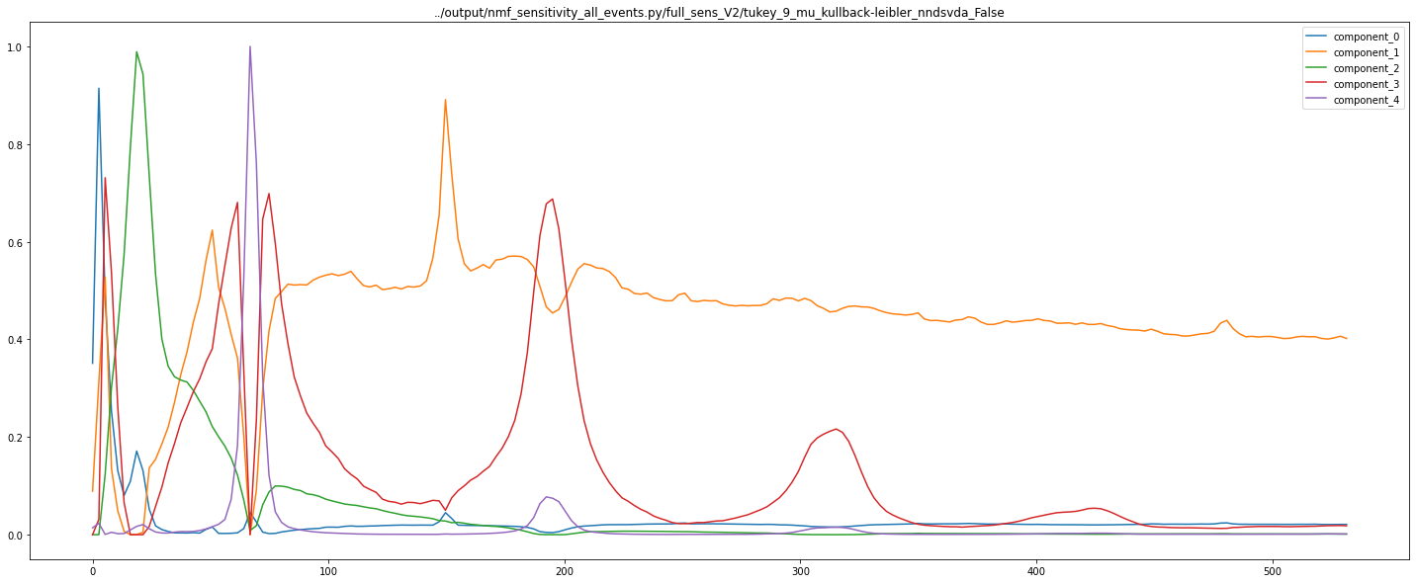

Slide 9
Quenched Diode

Slide 10
B28L8

Slide 11
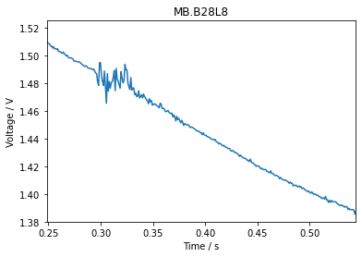
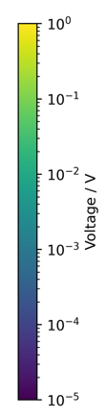
RB.A78 - B28L8 – Intercoil short
Event with B28L8 quench before:
2021-03-28: „normal“ at EE plateaus

Slide 12
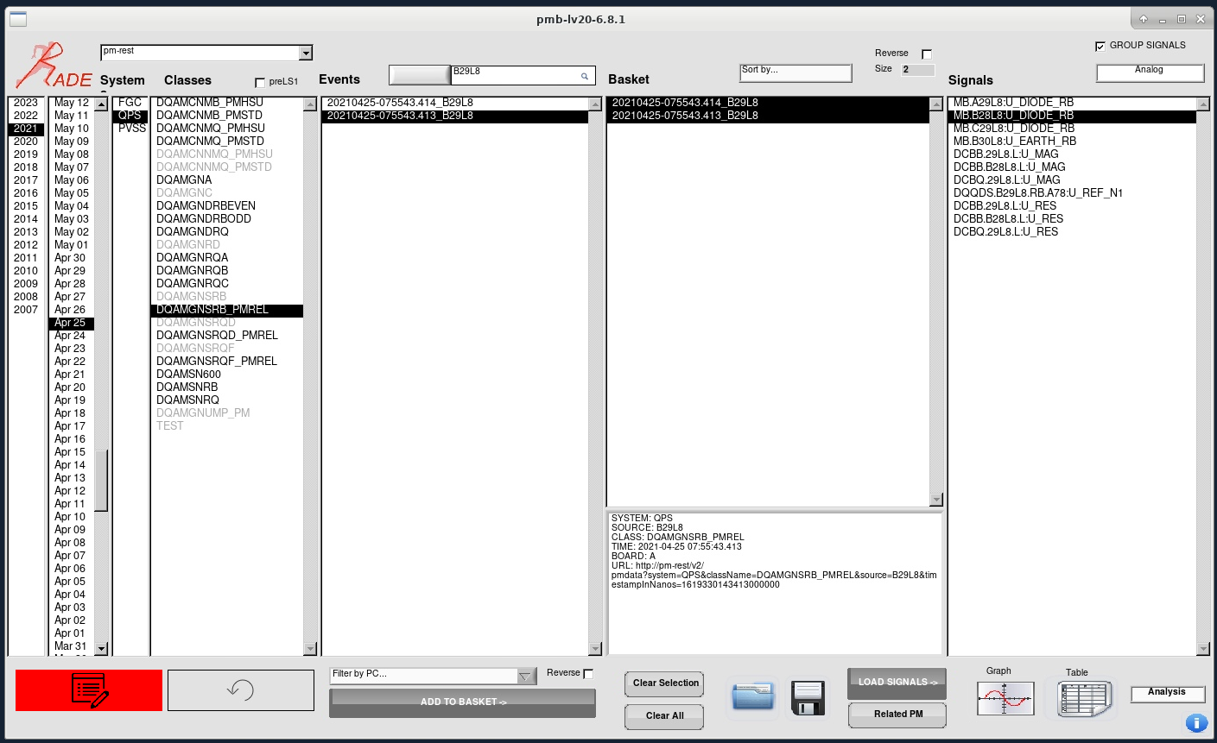
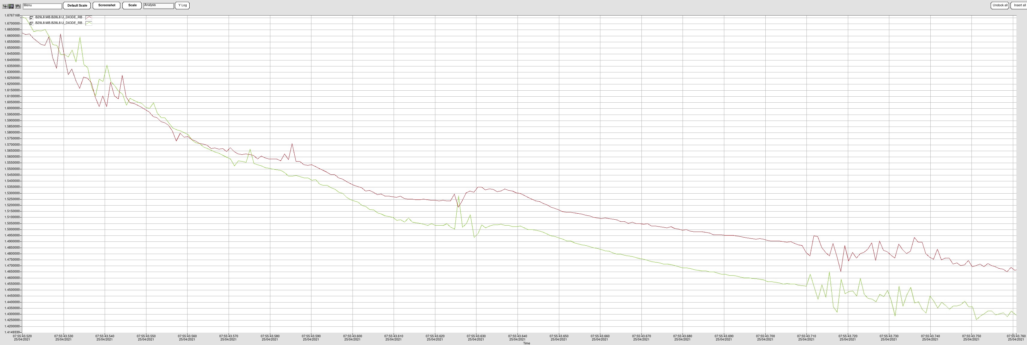

Slide 13
C17L5

Slide 14
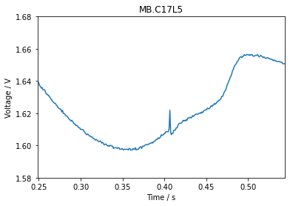
RB.A45 - C17L5
Events with C17L5 quench before:
2021-05-07: „normal“ at EE plateaus
2021-05-07: „normal“ at EE plateaus
A17L5, E89
B16L5, E88
C16L5, E66

Slide 15
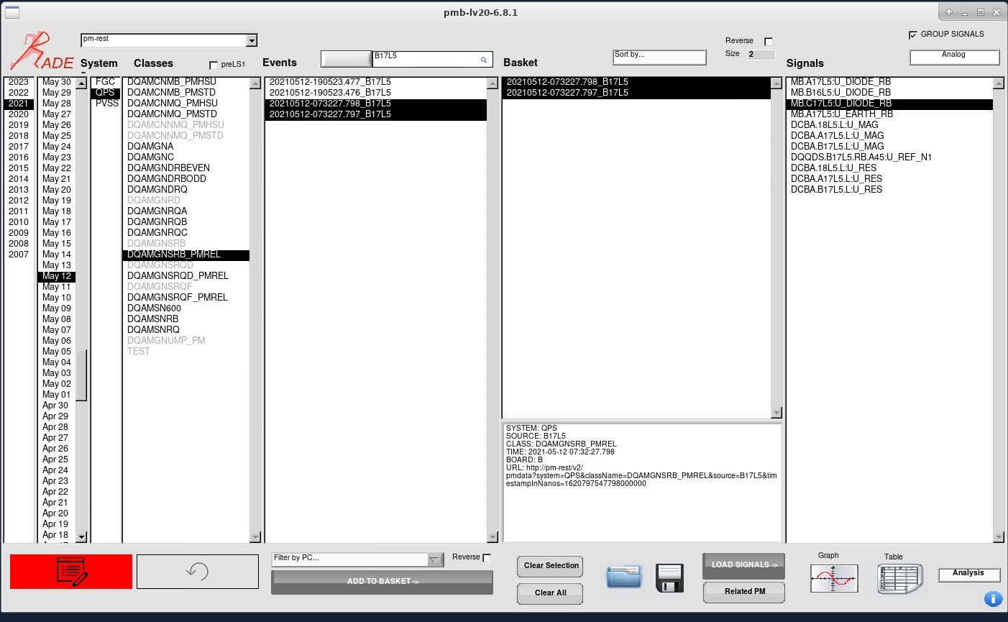
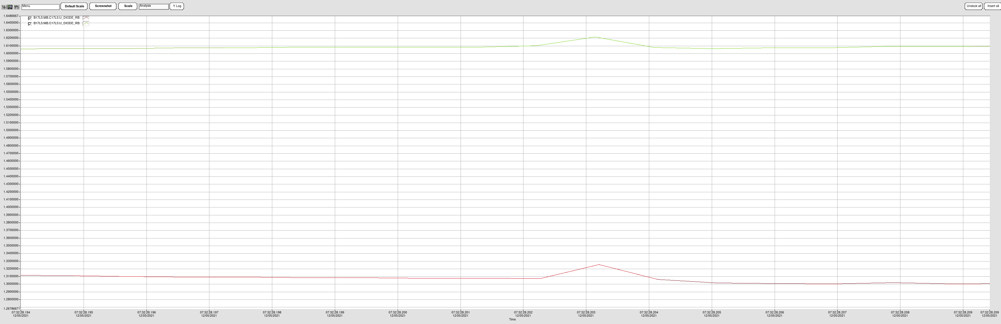

Slide 16
A32L4

Slide 17
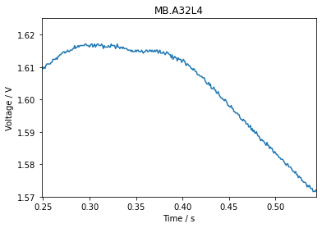
RB.A34 - A32L4
Events with A32L4 quench before:
2021-04-04: „normal“ at EE plateaus
2021-04-14: 3 fast sec. quenches
B33A4, E36
B33L4, E118
C32L4, E119
B32L4, E35

Slide 18
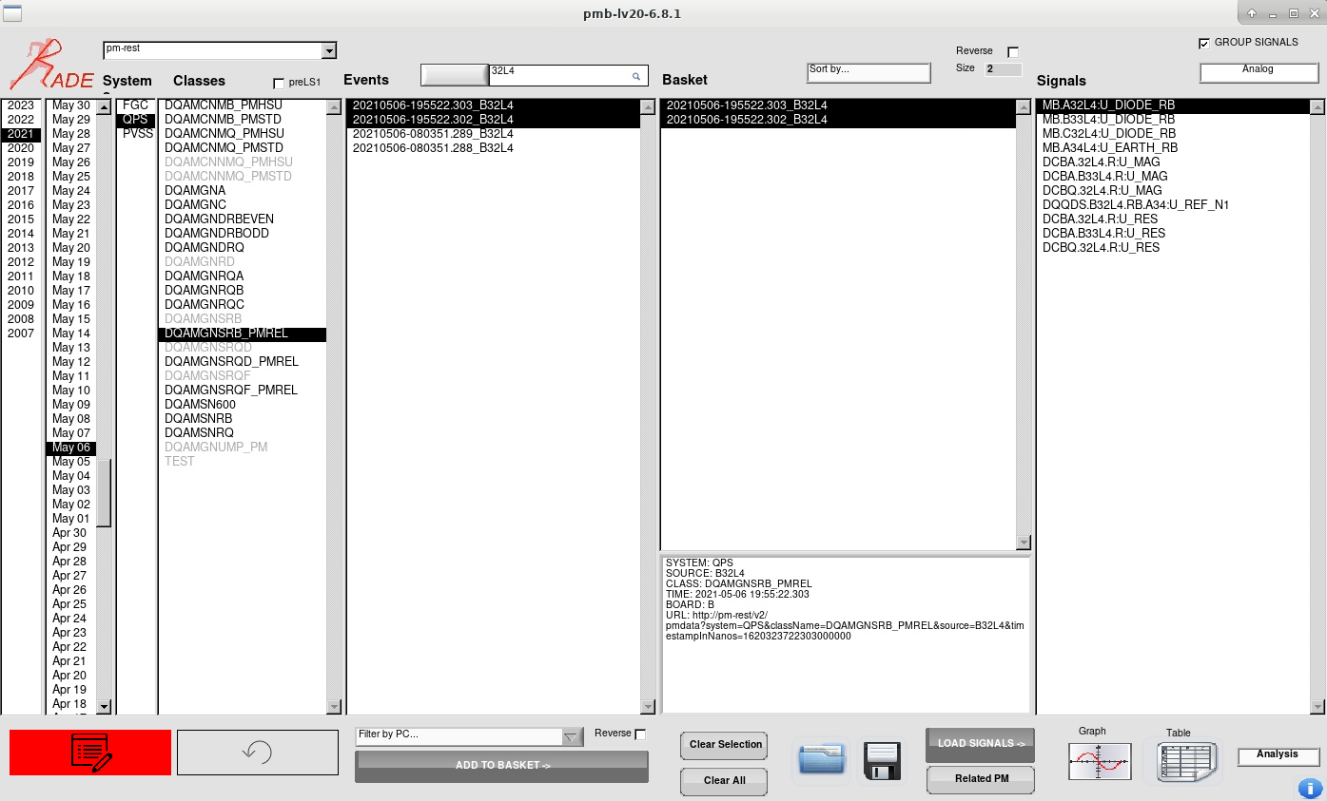
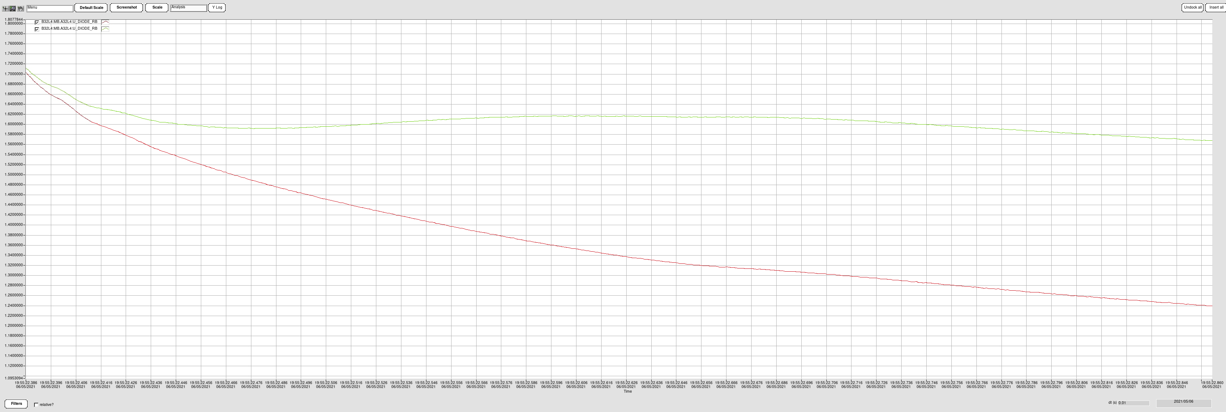

Slide 19
B11L8

Slide 20
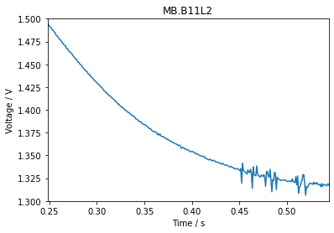
RB.A12 - B11L2
No B11L2 quench before
A11L2, E4
B10L2, E152
A9L2, E3
B9L2, E153

Slide 21
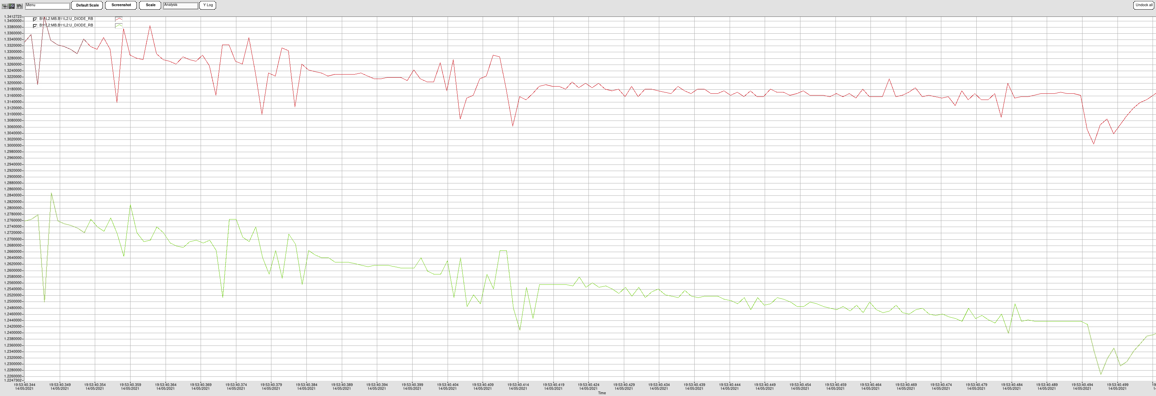

Slide 22
B28R3

Slide 23
RB.A34 – B28R3
No B28R3 quench before
Most likely scenario of noise from simulations:
Partially emerging resistor, in parallel to diode
Degraded diode contact?

Slide 24
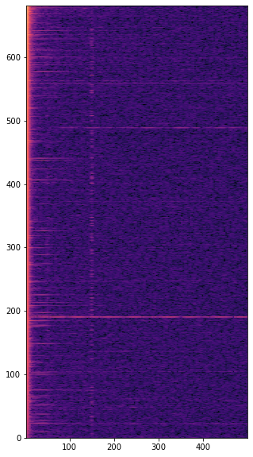
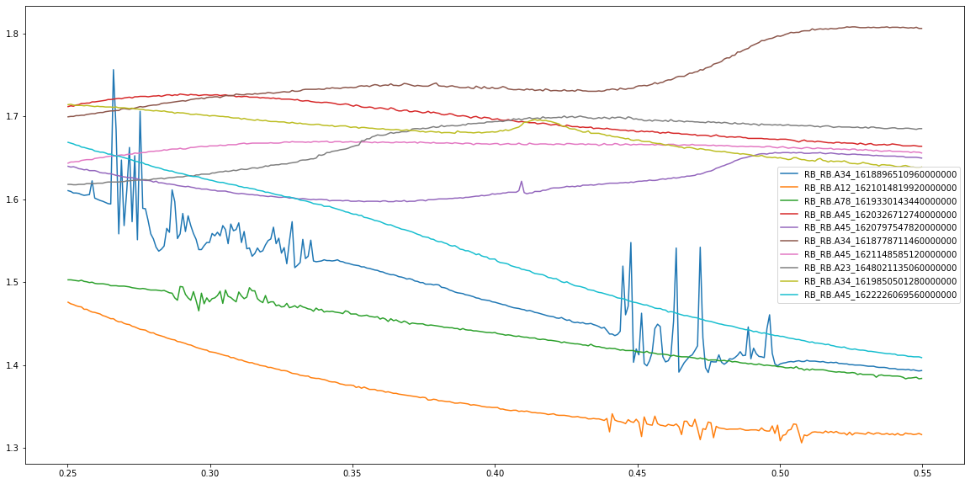

Slide 25
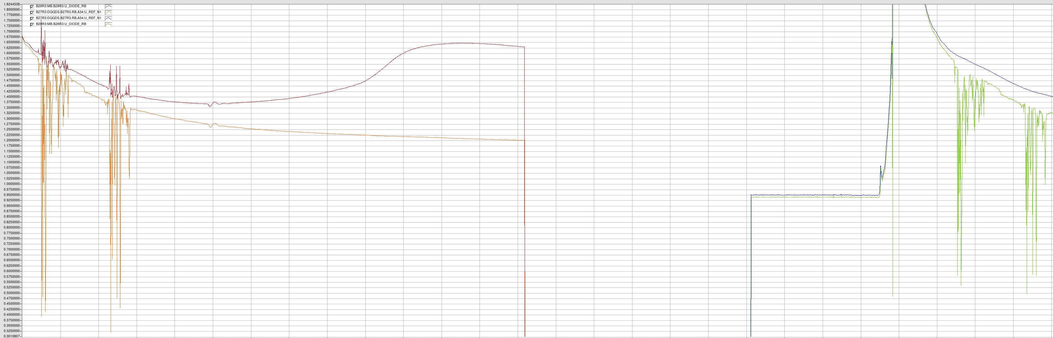

Slide 26
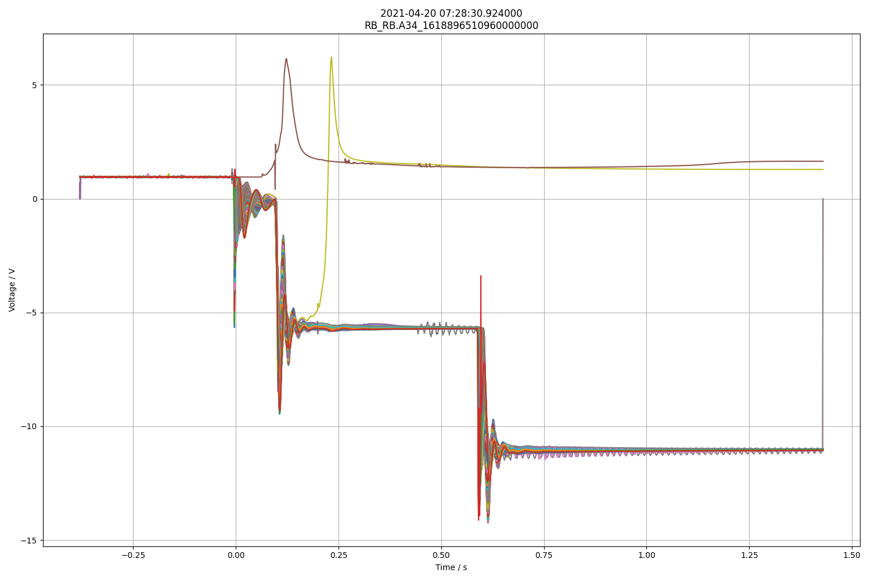

Slide 27
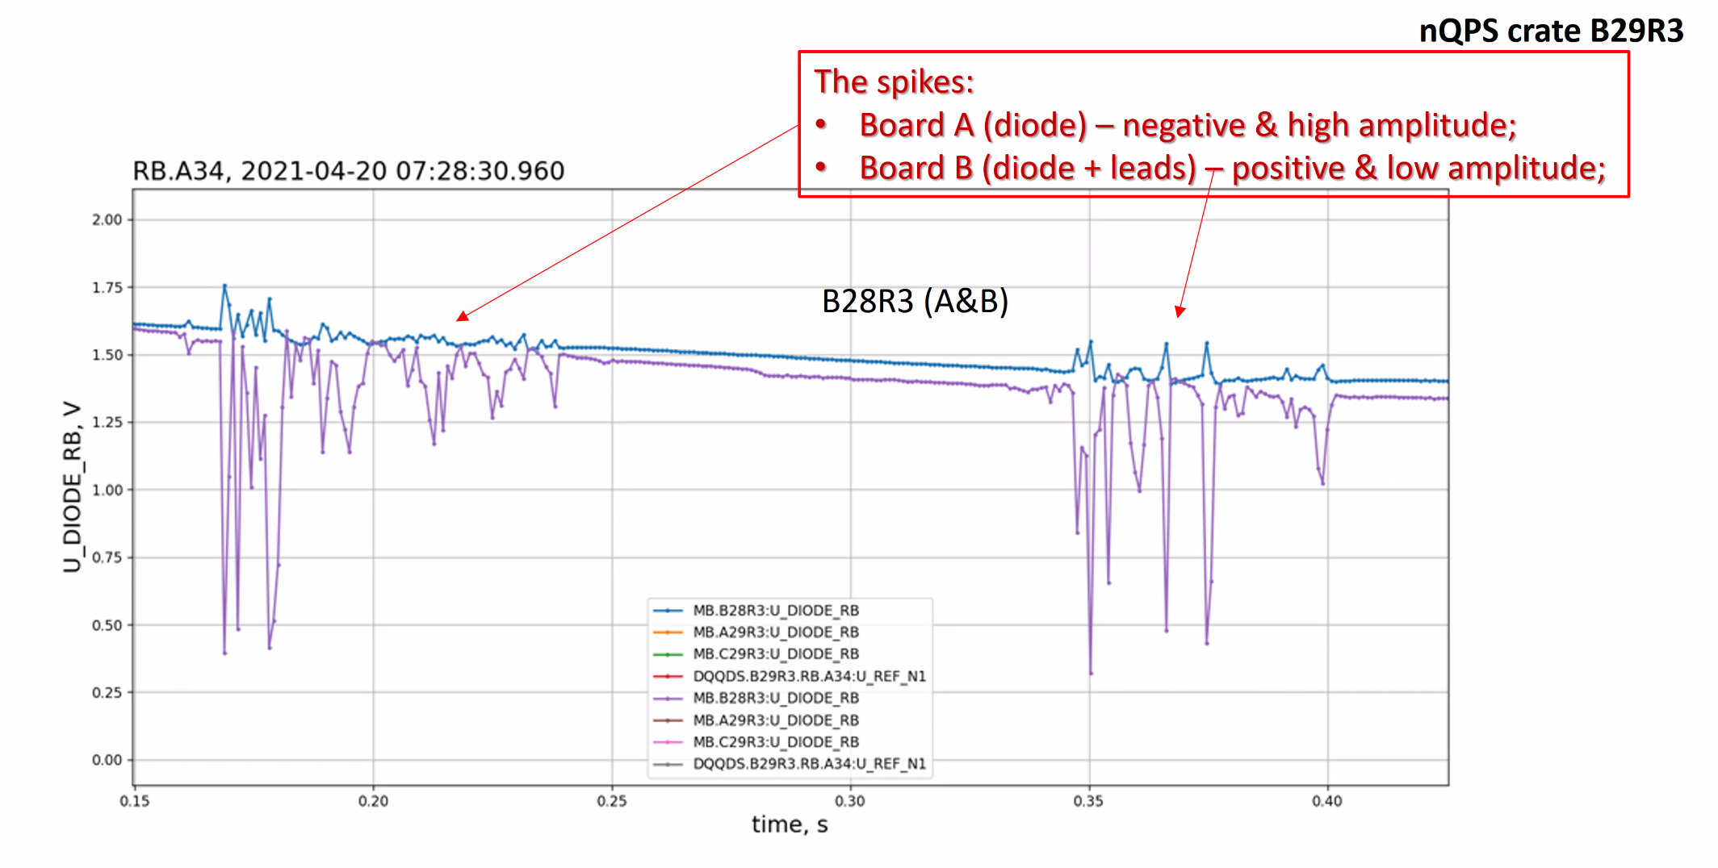
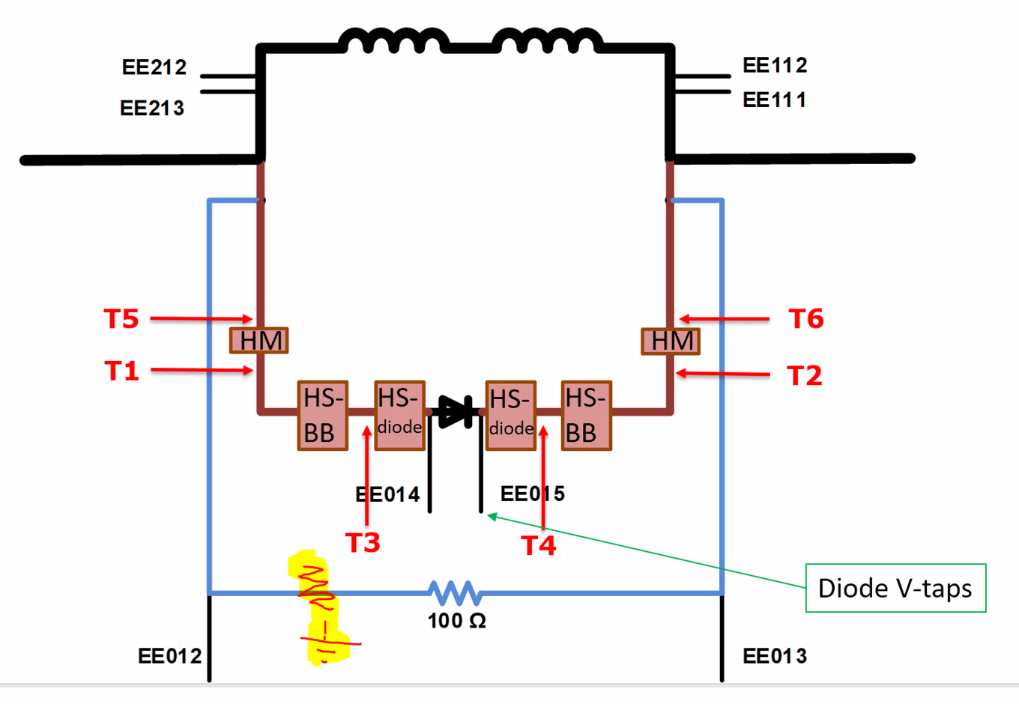

Slide 28
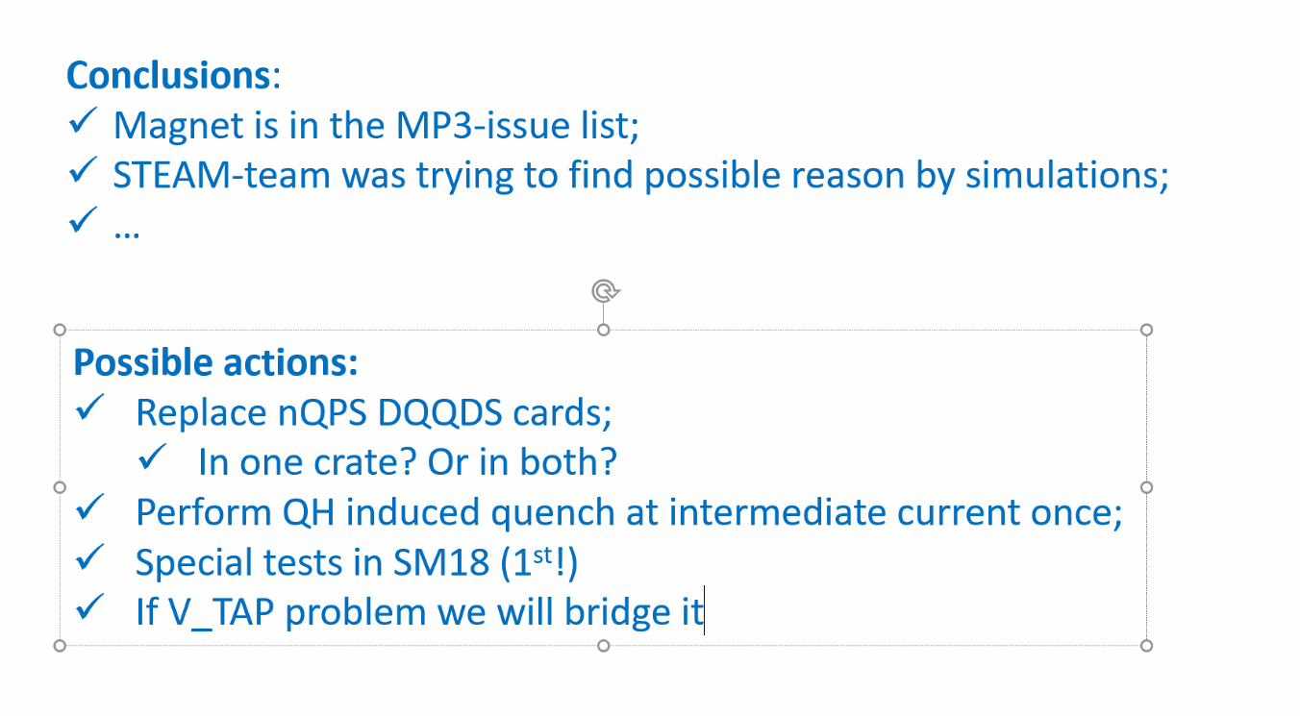

Slide 29
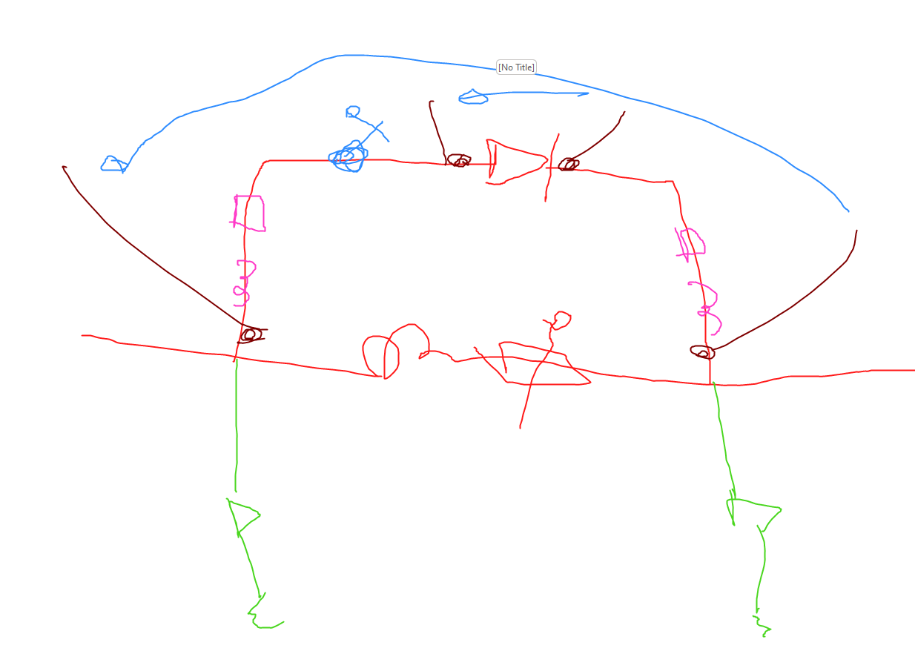
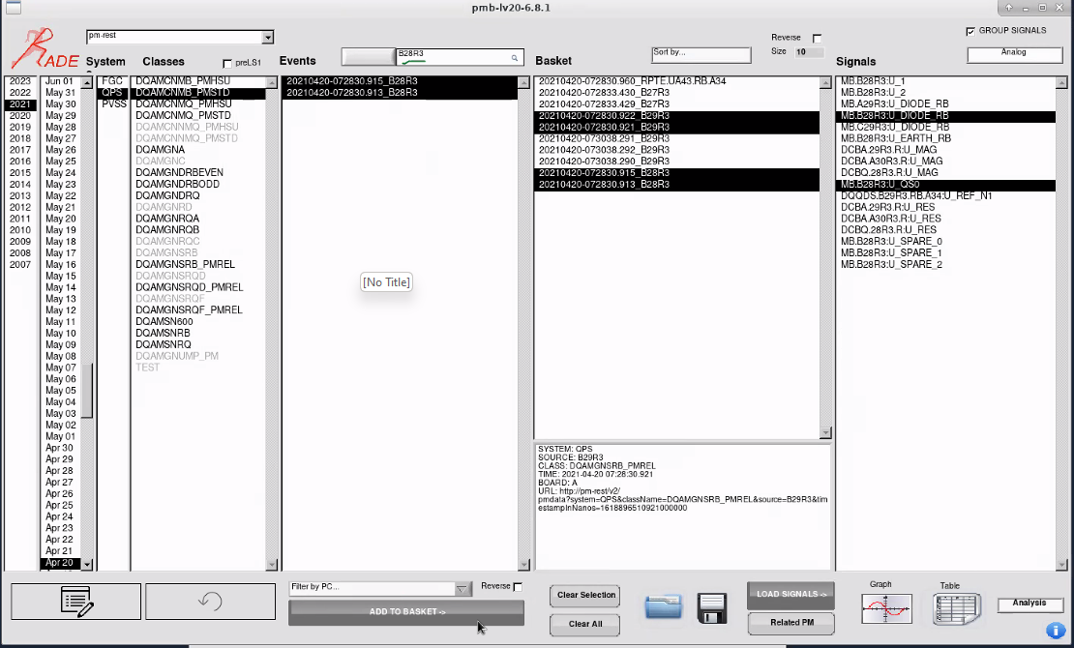

Slide 30
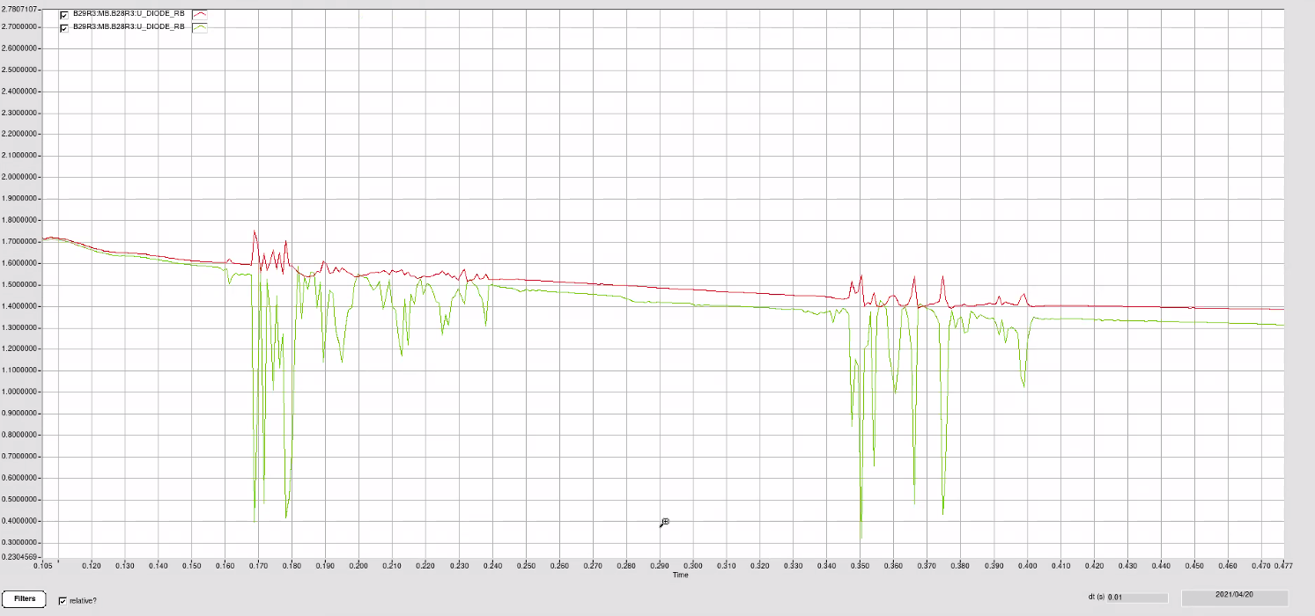

Slide 31
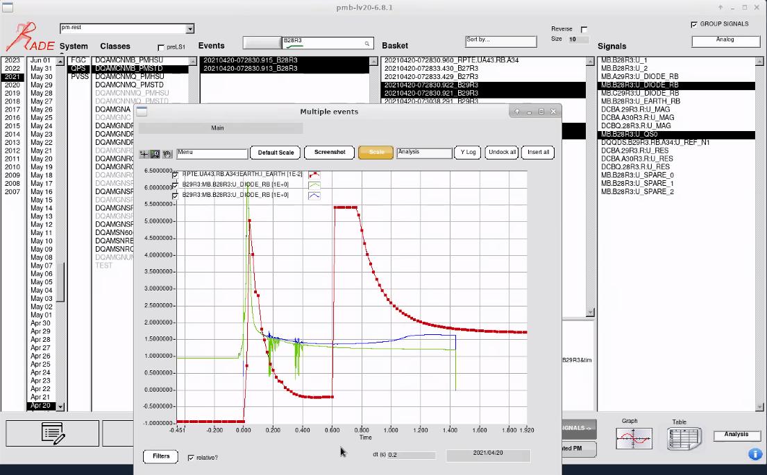

Slide 32
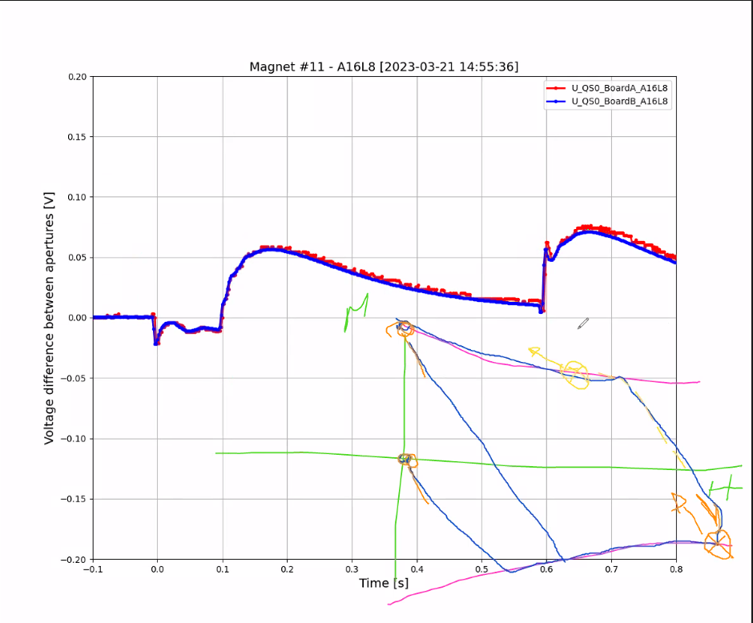

Slide 33
